Slide 1
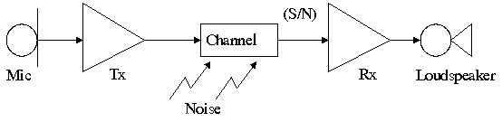
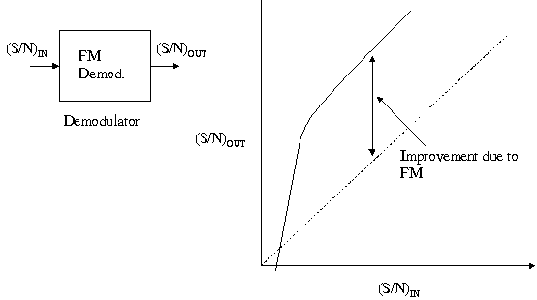
Introduction to Modulation and Demodulation
The purpose of a communication system is to transfer information from a source to a destination.
In practice, problems arise in baseband transmissions,
the major cases being:
Noise in the system – external noise
and circuit noise reduces the
signal-to-noise (S/N) ratio at the receiver
(Rx) input and hence reduces the
quality of the output.
Such a system is not able to fully utilise the available bandwidth,
for example telephone quality speech has a bandwidth ≃ 3kHz, a
co-axial cable has a bandwidth of 100's of Mhz.
Radio systems operating at baseband frequencies are very difficult.
Not easy to network.

Slide 2
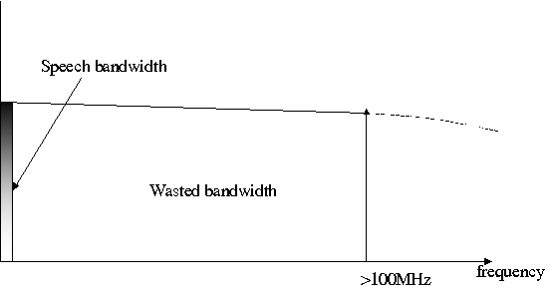
Multiplexing
Multiplexing is a modulation method which improves channel bandwidth utilisation.
For example, a co-axial cable has a bandwidth of 100's of Mhz.
Baseband speech is a only a few kHz

Slide 3
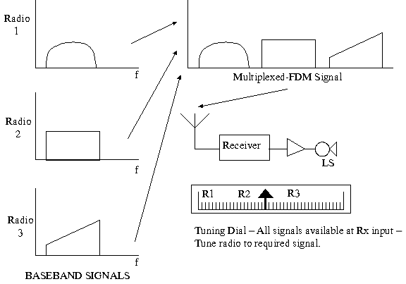
1) Frequency Division Multiplexing FDM
This allows several 'messages' to be translated from baseband, where they are all
in the same frequency band, to adjacent but non overlapping parts of the spectrum.
An example of FDM is broadcast radio (long wave LW, medium wave MW, etc.)

Slide 4
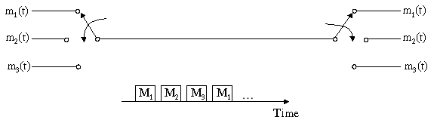
2) Time Division Multiplexing TDM
TDM is another form of multiplexing based on sampling which is a modulation
technique. In TDM, samples of several analogue message symbols, each one
sampled in turn, are transmitted in a sequence, i.e. the samples occupy adjacent
time slots.

Slide 5
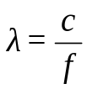
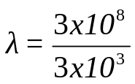
Radio Transmission
Aerial dimensions are of the same order as the wavelength, λ, of the signal
(e.g. quarter wave λ/4, λ/2 dipoles).
λ is related to frequency by
where c is the velocity of an electromagnetic wave, and c =
3x10⁸ m/sec in free space.
For baseband speech, with a signal at 3kHz, (3x10³Hz)
= 10⁵ metres or 100km.
Aerials of this size are impractical although some transmissions at Very Low Frequency (VLF) for specialist
applications are made.
A modulation process described as 'up-conversion' (similar to FDM) allows the baseband signal to be
translated to higher 'radio' frequencies.
Generally 'low' radio frequencies 'bounce' off the ionosphere and travel long distances around the earth,
high radio frequencies penetrate the ionosphere and make space communications possible.
The ability to 'up convert' baseband signals has implications on aerial dimensions and design, long distance
terrestrial communications, space communications and satellite communications. Background 'radio' noise
is also an important factor to be considered.
In a similar content, optical (fibre optic) communications is made possible by a modulation process in which
an optical light source is modulated by an information source.

Slide 6
Networks
A baseband system which is essentially point-to-point could be operated in a network. Some forms of access control (multiplexing) would be desirable otherwise the performance would be limited. Analogue communications networks have been in existence for a long time, for example speech radio networks for ambulance, fire brigade, police authorities etc.
For example, 'digital speech' communications, in which the analogue speech signal is converted to a digital signal via an analogue-to-digital converter give a form more convenient for transmission and processing.

Slide 7
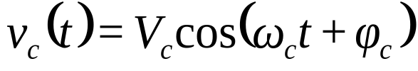
What is Modulation?
In modulation, a message signal, which contains the information is used to control the
parameters of a carrier signal, so as to impress the information onto the carrier.
The Messages
The message or modulating signal may be either:
analogue – denoted by m(t)
digital – denoted by d(t) – i.e. sequences of 1's and 0's
The message signal could also be a multilevel signal, rather than binary; this is not
considered further at this stage.
The Carrier
The carrier could be a 'sine wave' or a 'pulse train'.
Consider a 'sine wave' carrier:
If the message signal m(t) controls amplitude – gives AMPLITUDE MODULATION AM
If the message signal m(t) controls frequency – gives FREQUENCY MODULATION FM
If the message signal m(t) controls phase- gives PHASE MODULATION PM or φM

Slide 8

Considering now a digital message d(t):
If the message d(t) controls amplitude – gives AMPLITUDE SHIFT KEYING ASK.
As a special case it also gives a form of Phase Shift Keying (PSK) called PHASE REVERSAL
KEYING PRK.
If the message d(t) controls frequency – gives FREQUENCY SHIFT KEYING FSK.
If the message d(t) controls phase – gives PHASE SHIFT KEYING PSK.
In this discussion, d(t) is a binary or 2 level signal representing 1's and 0's
The types of modulation produced, i.e. ASK, FSK and PSK are sometimes described as binary
or 2 level, e.g. Binary FSK, BFSK, BPSK, etc. or 2 level FSK, 2FSK, 2PSK etc.
Thus there are 3 main types of Digital Modulation:
ASK, FSK, PSK.

Slide 9
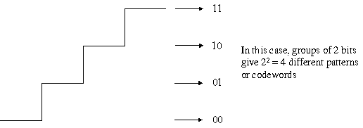
Multi-Level Message Signals
As has been noted, the message signal need not be either analogue (continuous) or
binary, 2 level. A message signal could be multi-level or m levels where each level
would represent a discrete pattern of 'information' bits. For example, m = 4 levels

Slide 10
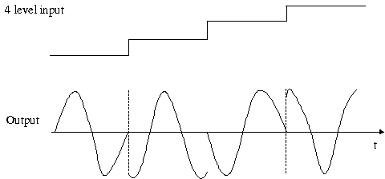
In general n bits per codeword will give 2n = m different patterns or levels.
Such signals are often called m-ary (compare with binary).
Thus, with m = 4 levels applied to:
Amplitude gives 4ASK or m-ary ASK
Frequency gives 4FSK or m-ary FSK
Phase gives 4PSK or m-ary PSK
4 level PSK is also called QPSK
(Quadrature Phase Shift Keying).

Slide 11
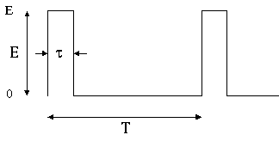
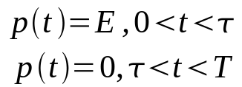
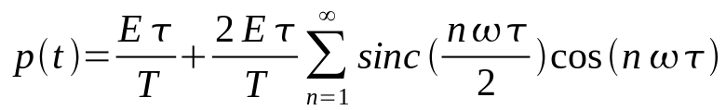
Consider Now A Pulse Train Carrier
where
and
The 3 parameters in the case are:
Pulse Amplitude E
Pulse width vt
Pulse position T
Hence:
If m(t) controls E – gives PULSE AMPLITUDE MODULATION PAM
If m(t) controls t - gives PULSE WIDTH MODULATION PWM
If m(t) controls T - gives PULSE POSITION MODULATION PPM
In principle, a digital message d(t) could be applied but this will not be considered further.

Slide 12
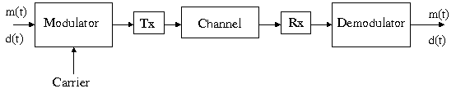
What is Demodulation?
Demodulation is the reverse process (to modulation) to recover the message signal
m(t) or d(t) at the receiver.

Slide 13
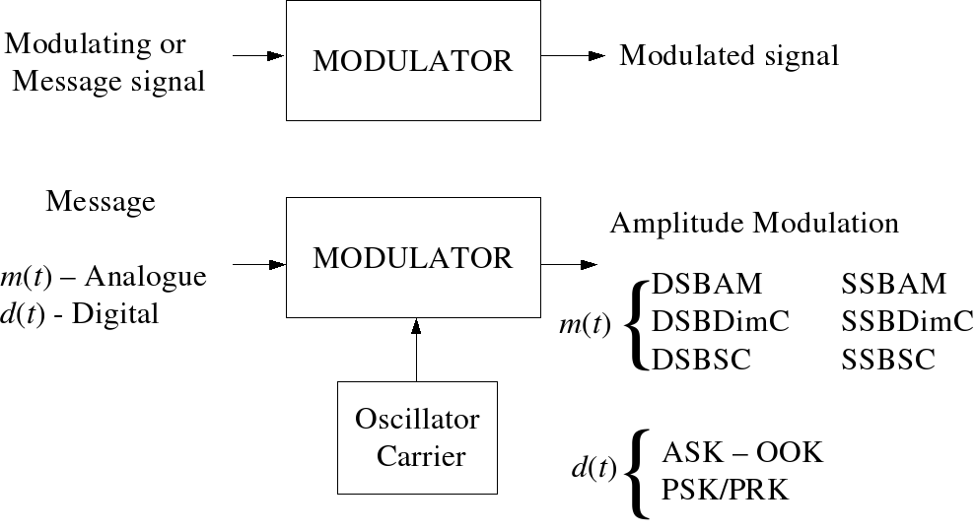
Summary of Modulation Techniques 1

Slide 14
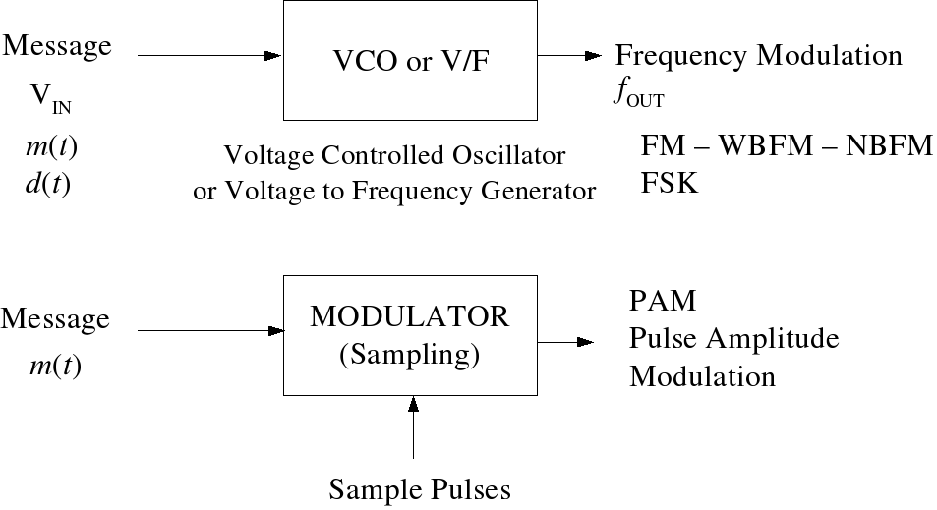
Summary of Modulation Techniques 2

Slide 15
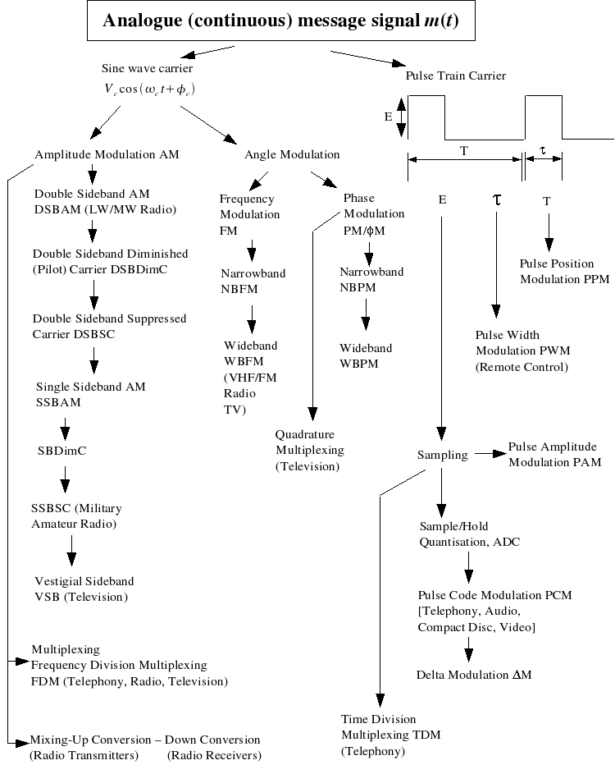
Summary of Modulation Techniques with some Derivatives and Familiar Applications

Slide 16
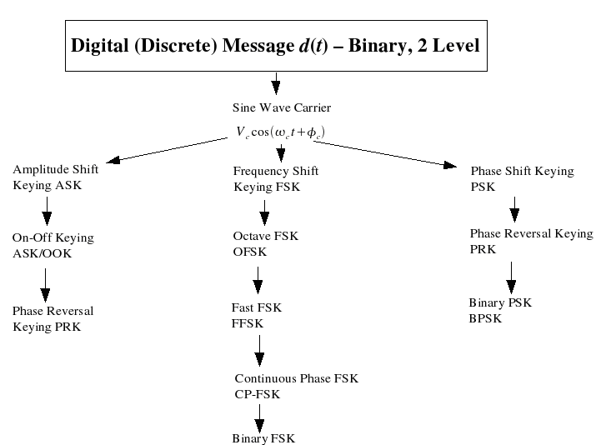
Summary of Modulation Techniques with some Derivatives and Familiar Applications

Slide 17
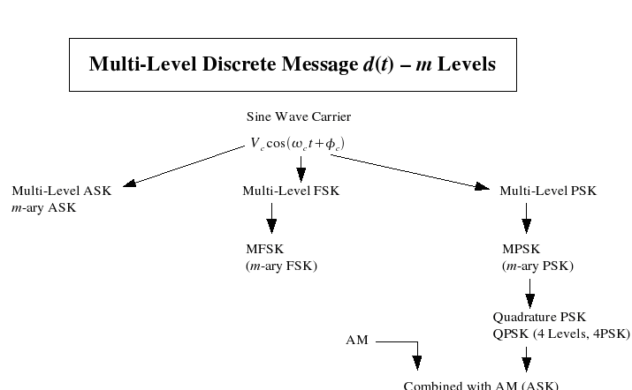
Summary of Modulation Techniques with some Derivatives and Familiar Applications 2

Slide 18
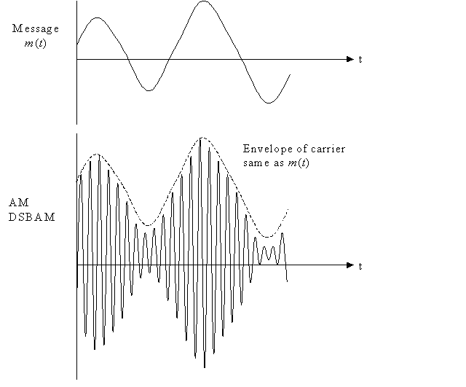
Modulation Types AM, FM, PAM

Slide 19
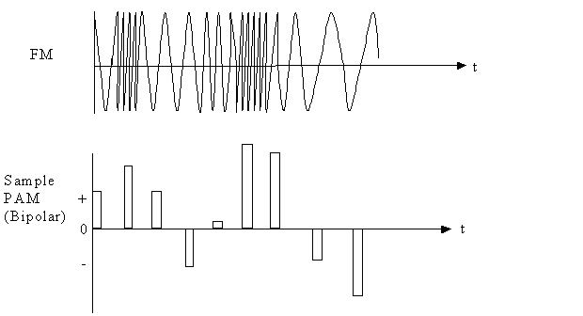
Modulation Types AM, FM, PAM 2

Slide 20
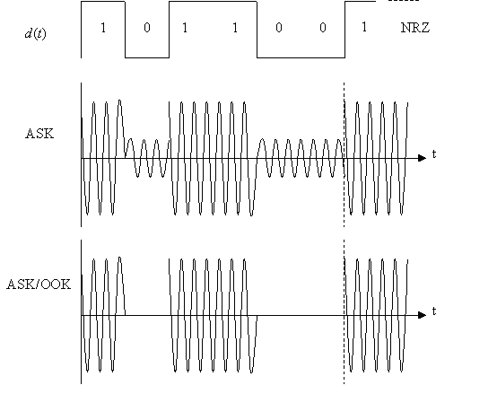
Modulation Types (Binary ASK, FSK, PSK)

Slide 21
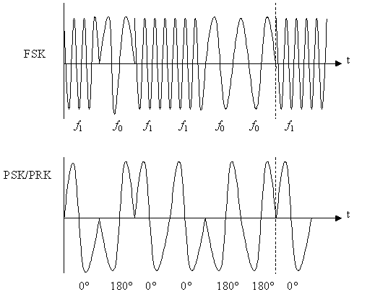
Modulation Types (Binary ASK, FSK, PSK) 2

Slide 22
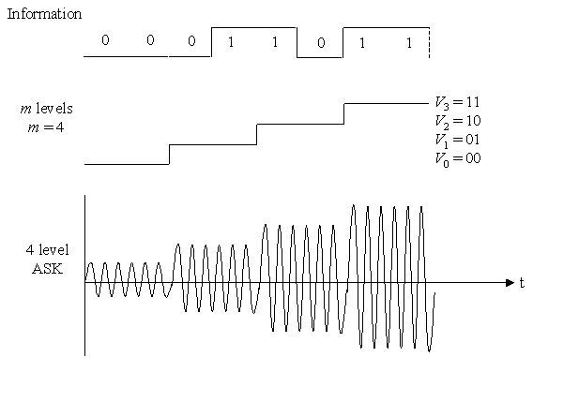
Modulation Types – 4 Level ASK, FSK, PSK

Slide 23
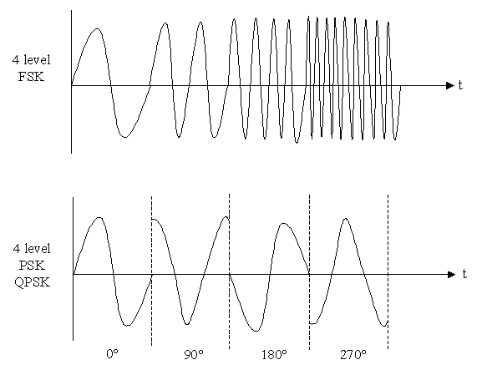
Modulation Types – 4 Level ASK, FSK, PSK 2

Slide 24
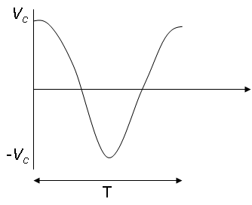
Analogue Modulation – Amplitude Modulation
Consider a 'sine wave' carrier.
v_{c}(t) = V_{c} cos(ω_{c}t), peak amplitude = V_{c}, carrier frequency ω_{c} radians per second.
Since ω_{c} = 2πf_{c}, frequency = f_{c} Hz where f_{c} = 1/T.
Amplitude Modulation AM
In AM, the modulating signal (the message signal) m(t) is 'impressed' on to the
amplitude of the carrier.

Slide 25
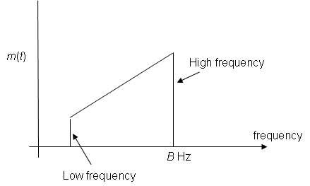
Message Signal m(t)
In general m(t) will be a band of signals, for example speech or video signals. A
notation or convention to show baseband signals for m(t) is shown below

Slide 26
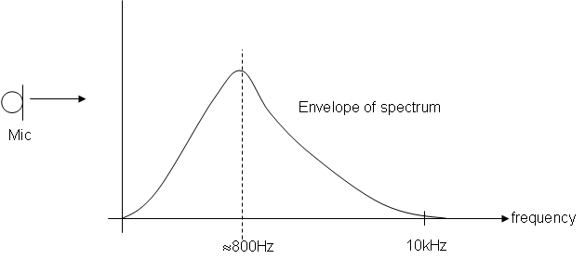
Message Signal m(t)
In general m(t) will be band limited. Consider for example, speech via a microphone.
The envelope of the spectrum would be like:

Slide 27
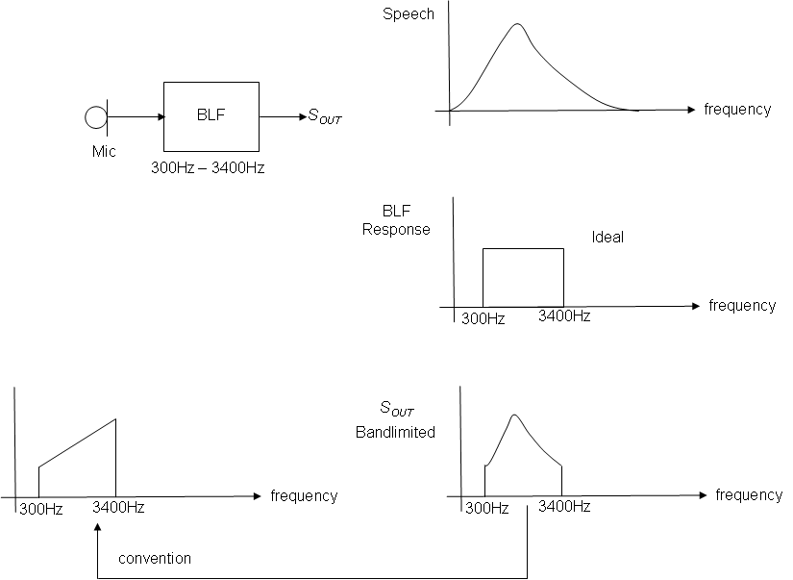

Message Signal m(t)
In order to make the analysis and indeed the testing of AM systems easier, it is common to make
m(t) a test signal, i.e. a signal with a constant amplitude and frequency given by

Slide 28
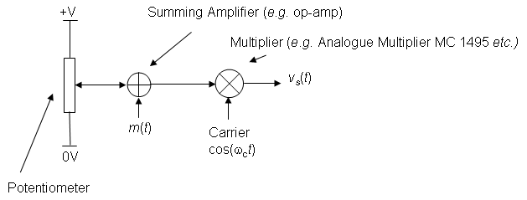
Schematic Diagram for Amplitude Modulation
V_{DC} is a variable voltage, which can be set between 0 Volts and +V Volts. This
schematic diagram is very useful; from this all the important properties of AM and
various forms of AM may be derived.

Slide 29
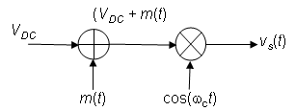


Equations for AM
From the diagram where V_{DC} is the DC voltage that can
be varied. The equation is in the form Amp cos ω_{c}t and we may 'see' that the amplitude
is a function of m(t) and V_{DC}. Expanding the equation we get:

Slide 30
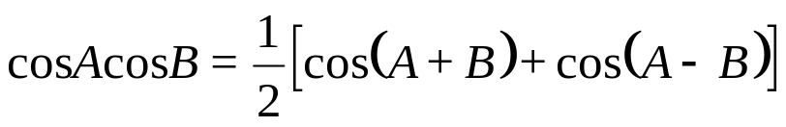
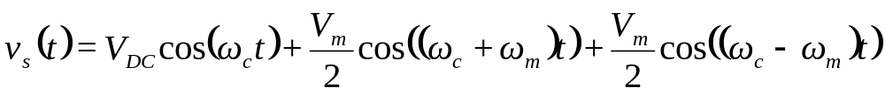
Equations for AM
Now let m(t) = V_{m} cos ω_{m}t, i.e. a 'test' signal,
Using the trig identity
we have
Components: Carrier upper sideband USB lower sideband LSB
Amplitude: V_{DC} V_{m}/2 V_{m}/2
Frequency: ω_{c} ω_{c} + ω_{m} ω_{c} – ω_{m}
f_{c} f_{c} + f_{m} f_{c} + f_{m}
This equation represents Double Amplitude Modulation – DSBAM

Slide 31
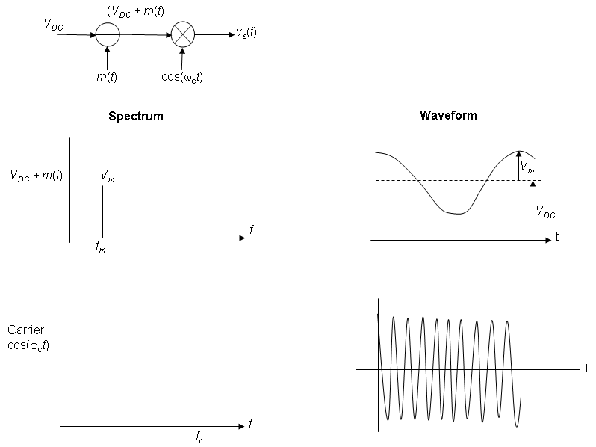
Spectrum and Waveforms
The following diagrams
represent the spectrum
of the input signals,
namely (V_{DC} + m(t)),
with m(t) = V_{m} cos ω_{m}t,
and the carrier cos ω_{c}t
and corresponding
waveforms.

Slide 32
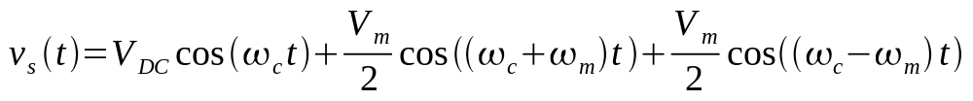
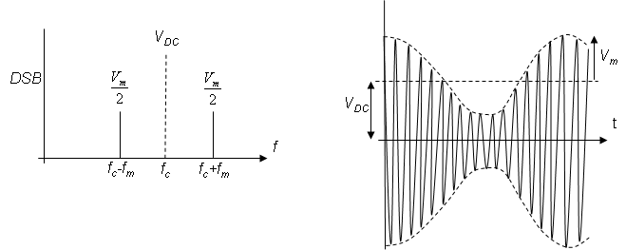
Spectrum and Waveforms
The above are input signals. The diagram below shows the spectrum and
corresponding waveform of the output signal, given by

Slide 33
Double Sideband AM, DSBAM
The component at the output at the carrier frequency f_{c} is shown as a broken line with
amplitude V_{DC} to show that the amplitude depends on V_{DC}. The structure of the
waveform will now be considered in a little more detail.
Waveforms
Consider again the diagram
V_{DC} is a variable DC offset added to the message; m(t) = V_{m} cos ω_{m}t

Slide 34
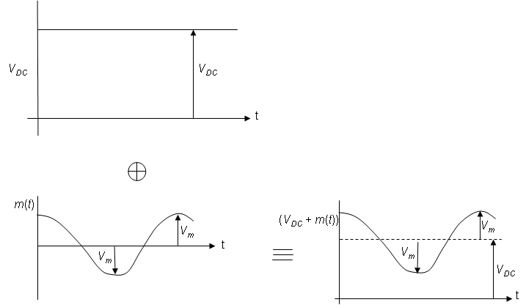

Double Sideband AM, DSBAM
This is multiplied by a carrier, cos ω_{c}t. We effectively multiply (V_{DC} + m(t)) waveform
by +1, -1, +1, -1, ...
The product gives the output signal

Slide 35
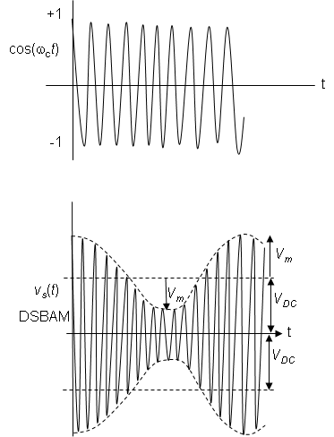
Double Sideband AM, DSBAM

Slide 36

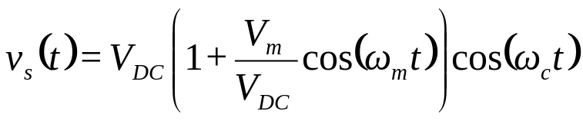
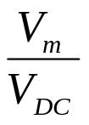
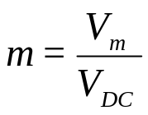
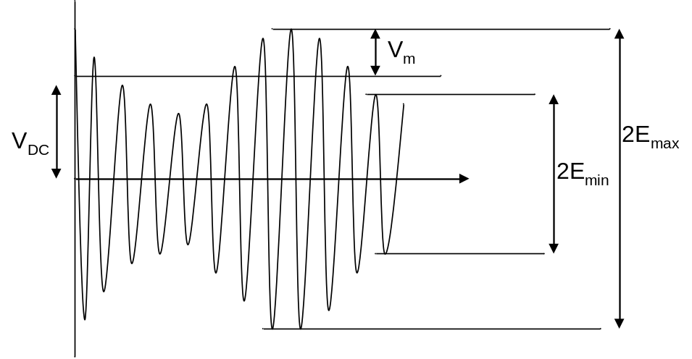
Modulation Depth
Consider again the equation
, which may be written as
The ratio is
defined as the modulation depth, m, i.e.
Modulation Depth
From an oscilloscope display the modulation depth for Double Sideband AM may be
determined as follows:

Slide 37
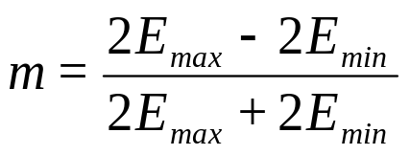


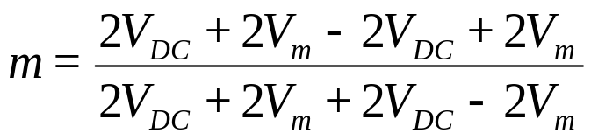
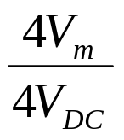
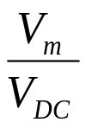
Modulation Depth 2
2E_{max} = maximum peak-to-peak of waveform
2E_{min} = minimum peak-to-peak of waveform
Modulation Depth
This may be shown to equal
as follows:
=
=

Slide 38
Double Sideband Modulation 'Types'
There are 3 main types of DSB
Double Sideband Amplitude Modulation, DSBAM – with carrier
Double Sideband Diminished (Pilot) Carrier, DSB Dim C
Double Sideband Suppressed Carrier, DSBSC
The type of modulation is determined by the modulation depth, which for a fixed m(t) depends on the DC offset, V_{DC}. Note, when a modulator is set up, V_{DC} is fixed at a particular value. In the following illustrations we will have a fixed message, V_{m} cos ω_{m}t and vary V_{DC} to obtain different types of Double Sideband modulation.

Slide 39
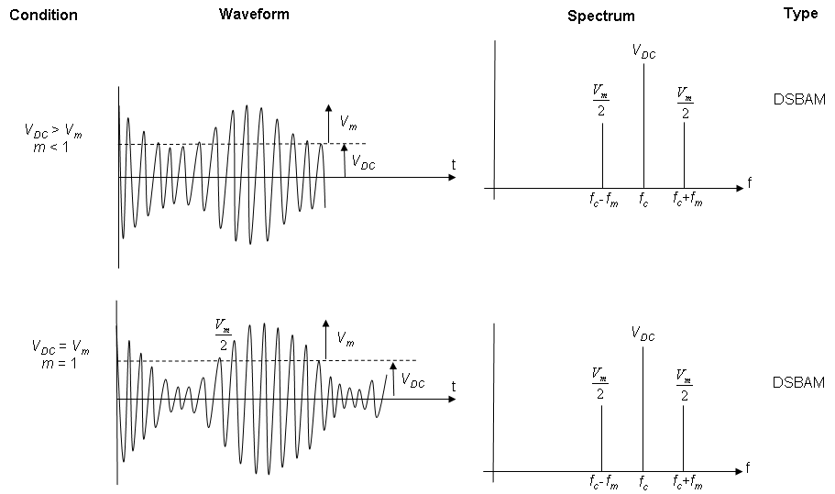
Graphical Representation of Modulation Depth and Modulation Types.

Slide 40
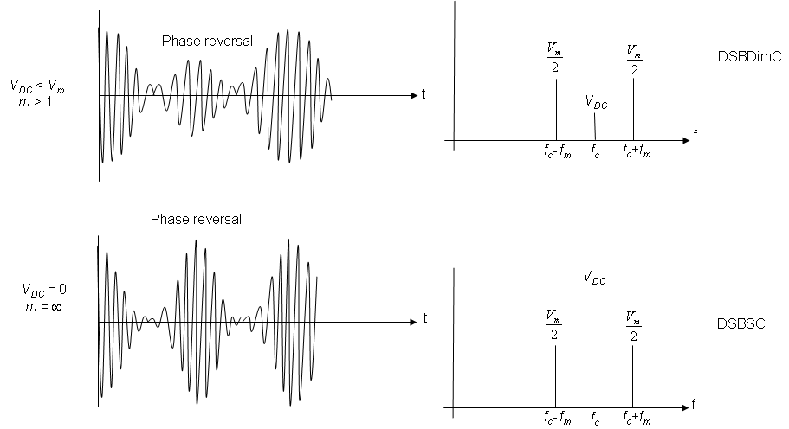
Graphical Representation of Modulation Depth and Modulation Types 2.

Slide 41
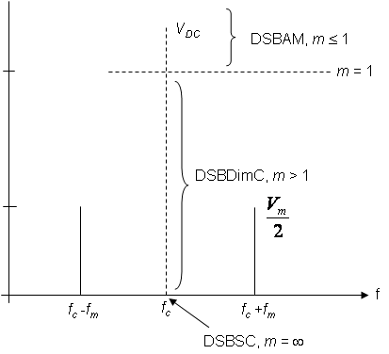
Graphical Representation of Modulation Depth and Modulation Types 3
Note then that V_{DC} may be set to give
the modulation depth and modulation
type.
DSBAM V_{DC} >> V_{m}, m ≤ 1
DSB Dim C 0 < V_{DC} < V_{m},
m > 1 (1 < m < ∞)
DSBSC V_{DC} = 0, m = ∞
The spectrum for the 3 main types of
amplitude modulation are summarised

Slide 42
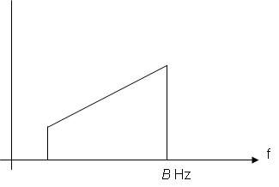

Bandwidth Requirement for DSBAM
In general, the message signal m(t) will not be a single 'sine' wave, but a band of frequencies
extending up to B Hz as shown
Remember – the 'shape' is used for convenience to distinguish low frequencies from high
frequencies in the baseband signal.

Slide 43
Bandwidth Requirement for DSBAM
Amplitude Modulation is a linear process, hence the principle of superposition applies. The output spectrum may be found by considering each component cosine wave in m(t) separately and summing at the output.
Note:
Frequency inversion of the LSB
the modulation process has effectively shifted or frequency translated the baseband m(t) message signal to USB and LSB signals centred on the carrier frequency f_{c}
the USB is a frequency shifted replica of m(t)
the LSB is a frequency inverted/shifted replica of m(t)
both sidebands each contain the same message information, hence either the LSB or USB could be removed (because they both contain the same information)
the bandwidth of the DSB signal is 2B Hz, i.e. twice the highest frequency in the baseband signal, m(t)
The process of multiplying (or mixing) to give frequency translation (or up-conversion) forms the basis of radio transmitters and frequency division multiplexing which will be discussed later.

Slide 44






Power Considerations in DSBAM
Remembering that Normalised Average Power = (V_{RMS})² =
we may tabulate for AM components as follows:
Component | Carrier | USB | LSB
Amplitude pk | V_{DC}
Power
Power
Total Power P_{T} =
Carrier Power P_{c}
+ P_{USB}
+ P_{LSB}

Slide 45






Power Considerations in DSBAM
From this we may write two equivalent equations for the total power P_{T}, in a DSBAM signal
and
The carrier power
i.e.
or
Either of these forms may be useful. Since both USB and LSB contain the same information a
useful ratio which shows the proportion of 'useful' power to total power is

Slide 46


Power Considerations in DSBAM
For DSBAM (m ≤ 1), allowing for m(t) with a dynamic range, the average value of m
may be assumed to be m = 0.3
Hence,
Hence, on average only about 2.15% of the total power transmitted may be regarded
as 'useful' power. (≈ 95.7% of the total power is in the carrier!)
Even for a maximum modulation depth of m = 1 for DSBAM the ratio
i.e. only 1/6th of the total power is 'useful' power (with 2/3 of the total power in the
carrier).

Slide 47




Example
Suppose you have a portable (for example you carry it in your ' back pack') DSBAM transmitter
which needs to transmit an average power of 10 Watts in each sideband when modulation depth
m = 0.3. Assume that the transmitter is powered by a 12 Volt battery. The total power will be
where
= 10 Watts, i.e.
= 444.44 Watts
Hence, total power P_{T} = 444.44 + 10 + 10 = 464.44 Watts.
Hence, battery current (assuming ideal transmitter) = Power / Volts =
amps!
i.e. a large and heavy 12 Volt battery.
Suppose we could remove one sideband and the carrier, power transmitted would be
10 Watts, i.e. 0.833 amps from a 12 Volt battery, which is more reasonable for a
portable radio transmitter.

Slide 48

Single Sideband Amplitude Modulation
One method to produce signal sideband (SSB) amplitude modulation is to produce
DSBAM, and pass the DSBAM signal through a band pass filter, usually called a
single sideband filter, which passes one of the sidebands as illustrated in the diagram
below.
The type of SSB may be SSBAM (with a 'large' carrier component), SSBDimC or
SSBSC depending on V_{DC} at the input. A sequence of spectral diagrams are shown
on the next page.

Slide 49

Single Sideband Amplitude Modulation

Slide 50

Single Sideband Amplitude Modulation
Note that the bandwidth of the SSB signal B Hz is half of the DSB signal bandwidth.
Note also that an ideal SSB filter response is shown. In practice the filter will not be
ideal as illustrated.
As shown, with practical filters some part of the rejected sideband (the LSB in this
case) will be present in the SSB signal. A method which eases the problem is to
produce SSBSC from DSBSC and then add the carrier to the SSB signal.

Slide 51

Single Sideband Amplitude Modulation

Slide 52



Single Sideband Amplitude Modulation
with m(t) = V_{m} cos ω_{m}t, we may write:
The SSB filter removes the LSB (say) and the output is
Again, note that the output may be
SSBAM, V_{DC} large
SSBDimC, V_{DC} small
SSBSC, V_{DC} = 0
For SSBSC, output signal =

Slide 53





Power in SSB
From previous discussion, the total power in the DSB signal is
=
for DSBAM.
Hence, if P_{c} and m are known, the carrier power and power in one sideband may be
determined. Alternatively, since SSB signal =
then the power in SSB signal (Normalised Average Power) is
Power in SSB signal =

Slide 54
Demodulation of Amplitude Modulated Signals
There are 2 main methods of AM Demodulation:
Envelope or non-coherent Detection/Demodulation.
Synchronised or coherent Demodulation.

Slide 55

Envelope or Non-Coherent Detection
An envelope detector for AM is shown below:
This is obviously simple, low cost. But the AM input must be DSBAM with m << 1, i.e.
it does not demodulate DSBDimC, DSBSC or SSBxx.

Slide 56

Large Signal Operation
For large signal inputs, (≈ Volts) the diode is switched i.e. forward biased ≡ ON, reverse
biased ≡ OFF, and acts as a half wave rectifier. The 'RC' combination acts as a 'smoothing
circuit' and the output is m(t) plus 'distortion'.
If the modulation depth is > 1, the distortion below occurs

Slide 57


Small Signal Operation – Square Law Detector
For small AM signals (~ millivolts) demodulation depends on the diode square law
characteristic.
The diode characteristic is of the form i(t) = av + bv2 + cv3 + ..., where
i.e. DSBAM signal.

Slide 58


Small Signal Operation – Square Law Detector
i.e.
=
=
=
'LPF' removes components.
Signal out =
i.e. the output contains m(t)

Slide 59

Synchronous or Coherent Demodulation
A synchronous demodulator is shown below
This is relatively more complex and more expensive. The Local Oscillator (LO) must be
synchronised or coherent, i.e. at the same frequency and in phase with the carrier in the
AM input signal. This additional requirement adds to the complexity and the cost.
However, the AM input may be any form of AM, i.e. DSBAM, DSBDimC, DSBSC or
SSBAM, SSBDimC, SSBSC. (Note – this is a 'universal' AM demodulator and the
process is similar to correlation – the LPF is similar to an integrator).

Slide 60

Synchronous or Coherent Demodulation
If the AM input contains a small or large component at the carrier frequency, the LO
may be derived from the AM input as shown below.

Slide 61


Synchronous (Coherent) Local Oscillator
If we assume zero path delay between the modulator and demodulator, then the ideal
LO signal is cos(ω_{c}t). Note – in general the will be a path delay, say τ, and the LO
would then be cos(ω_{c}(t – τ), i.e. the LO is synchronous with the carrier implicit in the
received signal. Hence for an ideal system with zero path delay
Analysing this for a DSBAM input =

Slide 62




Synchronous (Coherent) Local Oscillator
V_{X} = AM input x LO
=
=
=
We will now examine the signal spectra from 'modulator to V_{x'}

Slide 63

Synchronous (Coherent) Local Oscillator
(continued
on next
page)

Slide 64




Synchronous (Coherent) Local Oscillator
_{and}
_{and}
_{and}
_{and}
_{and}
Note – the AM input has been 'split into two' – 'half' has moved or shifted up to
and half shifted down to baseband,
and

Slide 65


Synchronous (Coherent) Local Oscillator
The LPF with a cut-off frequency ≈ f_{c} will pass only the baseband signal i.e.
In general the LO may have a frequency offset, Δω, and/or a phase offset, Δφ, i.e.
The AM input is essentially either:
DSB (DSBAM, DSBDimC, DSBSC)
SSB (SSBAM, SSBDimC, SSBSC)

Slide 66




1. Double Sideband (DSB) AM Inputs
The equation for DSB is
where VDC allows full carrier (DSBAM),
diminished carrier or suppressed carrier to be set.
Hence, Vx = AM Input x LO
Since

Slide 67





1. Double Sideband (DSB) AM Inputs
The LPF with a cut-off frequency ≈ f_{c} Hz will remove the components at 2ω_{c} (i.e.
components above ω_{c}) and hence
Obviously, if
and
we have, as previously
Consider now if Δω is equivalent to a few Hz offset from the ideal LO. We may then
say
The output, if speech and processed by the human brain may be intelligible, but
would include a low frequency 'buzz' at Δω, and the message amplitude would
fluctuate. The requirement Δω = 0 is necessary for DSBAM.

Slide 68

1. Double Sideband (DSB) AM Inputs
Consider now if Δω is equivalent to a few Hz offset from the ideal LO. We may then
say
The output, if speech and processed by the human brain may be intelligible, but would
include a low frequency 'buzz' at Δω, and the message amplitude would fluctuate. The
requirement Δω = 0 is necessary for DSBAM.
Consider now that Δω = 0 but Δφ ≠ 0, i.e. the frequency is correct at ω_{c} but there is a
phase offset. Now we have
'cos(Δφ)' causes fading (i.e. amplitude reduction) of the output.

Slide 69






1. Double Sideband (DSB) AM Inputs
The 'V_{DC}' component is not important, but consider for m(t),
if
(90⁰),
i.e.
if
(180⁰),
i.e.
The phase inversion if Δφ = π may not be a problem for speech or music, but it may be
a problem if this type of modulator is used to demodulate PRK
However, the major problem is that as Δφ increases towards
the signal strength
output gets weaker (fades) and at
the output is zero

Slide 70

1. Double Sideband (DSB) AM Inputs
If the phase offset varies with time, then the signal fades in and out. The variation of
amplitude of the output, with phase offset Δφ is illustrated below
Thus the requirement for Δω = 0 and Δφ = 0 is a 'strong' requirement for DSB amplitude
modulation.

Slide 71




2. Single Sideband (SSB) AM Input
The equation for SSB with a carrier depending on V_{DC} is
i.e. assuming
Hence
=

Slide 72




2. Single Sideband (SSB) AM Input
The LPF removes the 2ω_{c} components and hence
Note, if Δω = 0 and Δφ = 0,
,i.e.
has been
recovered.
Consider first that Δω ≠ 0, e.g. an offset of say 50Hz. Then
If m(t) is a signal at say 1kHz, the output contains a signal a 50Hz, depending on V_{DC}
and the 1kHz signal is shifted to 1000Hz - 50Hz = 950Hz.

Slide 73


2. Single Sideband (SSB) AM Input
The spectrum for V_{out} with Δω offset is shown
Hence, the effect of the offset Δω is to shift the baseband output, up or down, by Δφ.
For speech, this shift is not serious (for example if we receive a 'whistle' at 1kHz and
the offset is 50Hz, you hear the whistle at 950Hz (Δω = +ve) which is not very
noticeable. Hence, small frequency offsets in SSB for speech may be tolerated.
Consider now that Δω = 0, Δφ = 0, then

Slide 74
2. Single Sideband (SSB) AM Input
This indicates a fading V_{DC} and a phase shift in the output. If the variation in Δφ with time is relatively slow, thus phase shift variation of the output is not serious for speech.
Hence, for SSB small frequency and phase variations in the LO are tolerable. The requirement for a coherent LO is not as a stringent as for DSB. For this reason, SSBSC (suppressed carrier) is widely used since the receiver is relatively more simple than for DSB and power and bandwidth requirements are reduced.

Slide 75
Comments
In terms of 'evolution', early radio schemes and radio on long wave (LW) and medium wave (MW) to this day use DSBAM with m < 1. The reason for this was the reduced complexity and cost of 'millions' of receivers compared to the extra cost and power requirements of a few large LW/MW transmitters for broadcast radio, i.e. simple envelope detectors only are required.
Nowadays, with modern integrated circuits, the cost and complexity of synchronous demodulators is much reduced especially compared to the additional features such as synthesised LO, display, FM etc. available in modern receivers.
Amplitude Modulation forms the basis for:
Digital Modulation – Amplitude Shift Keying ASK
Digital Modulation – Phase Reversal Keying PRK
Multiplexing – Frequency Division Multiplexing FDM
Up conversion – Radio transmitters
Down conversion – Radio receivers

